Slide 1

Welcome all TCUSD STAFF
Business office

Slide 2
Staff
Payroll—Melinda Charley
Purchasing—Christina Charley
Student Activities—Cheryl Begay
Accounts Payable—Serena Whiterock
Food Service Technician—Brandon Shearer

Slide 3
Conflict of interest (COI)
Uniform System of Financial Records for Arizona School Districts (USFR) and Audit Compliance Questionnaire.
  GBMP03:
  The District annually obtained COI forms that allowed governing board members and employees to make known and fully disclose a COI in any contract, sale, purchase, service, or decision, and prior to accepting the forms, management reviewed the information to ensure governing board members and employees properly completed the form and sufficiently disclosed the required information. A.R.S. §§38-502 and 38-503

Slide 4
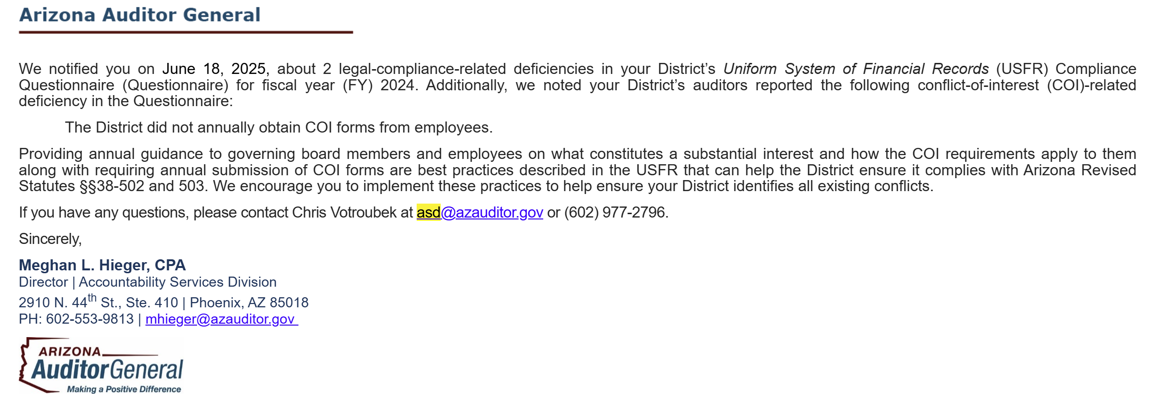
Arizona Auditor General

Slide 5
COI--Corrective Action
  Second year the district is not in compliance→corrective action.
  Powerpoint on the district website (tcusd.org): Human Resources
    Conflict of Interest Training
    Staff Conflict of Interest Form (GBEAA-E) (district website)

Slide 6
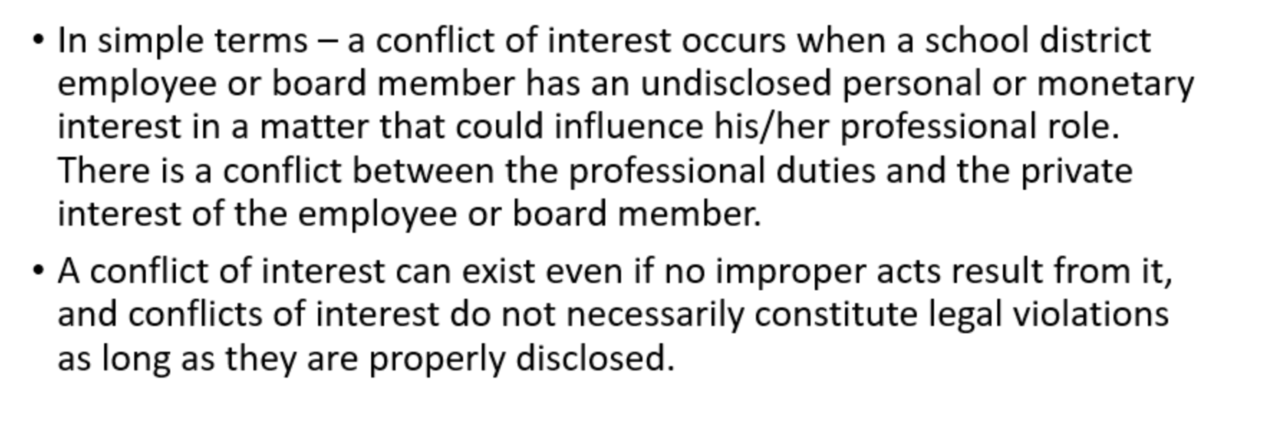
What is a Conflict of interest?

Slide 7
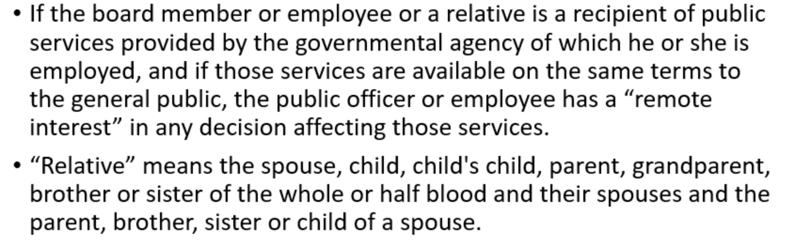

Slide 8
How does an employee/board member protect themselves?
Disclose any conflict of interest immediately by completing the COI form.
Do not accept gifts from vendors.
Refrain from being involved in any decision-making process where you have a conflict of interest.

Slide 9
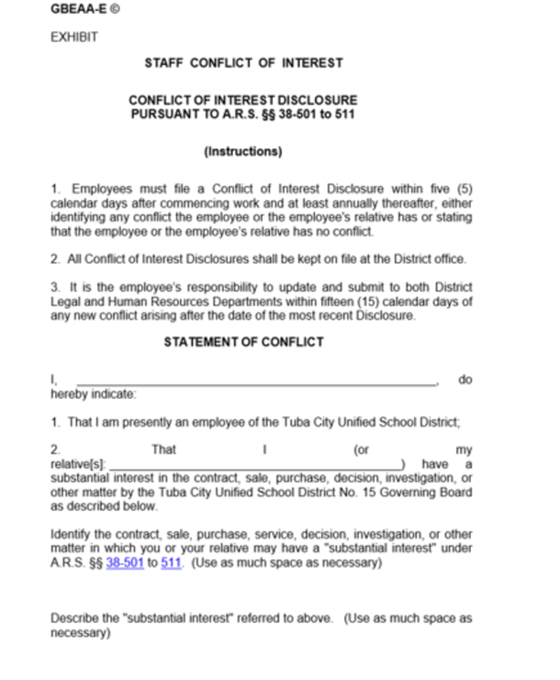

Slide 10
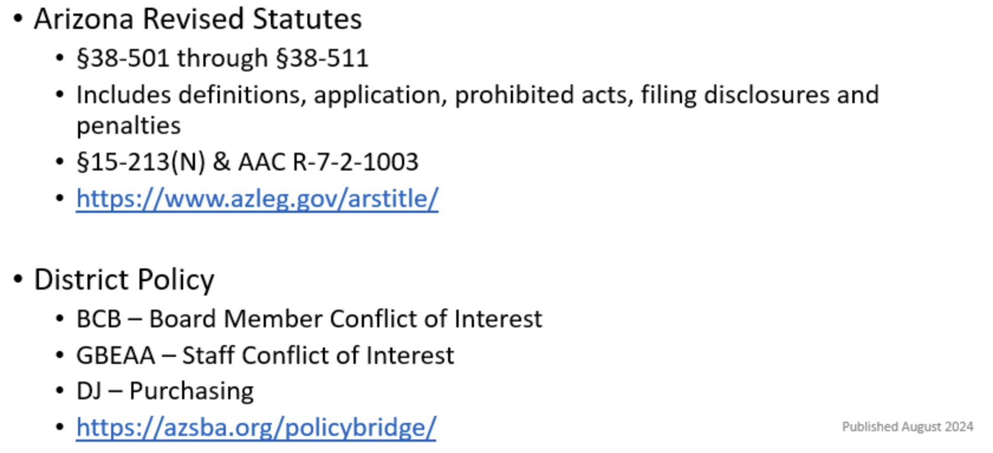
Policies and statues

Slide 11
Staff Dashborad
Employee Access—Direct Deposit Receipt, W-2, ect
  Contact HR and verify name spelling is correct and DOB.
  Compensation Statement—under My Pay and Pay & tax information. (audit requirement)
FMX—was our schooldude, maintenance and technology work-orders are submitted. Techonology will have training soon.
Payroll Update—Any changes need to be done in person and in writing.
  Change bank accounts
  Employee voluntary deductions
  W-4 & A-4 are done by HR.

Slide 12

SY 2025-2026
Student Activity HandBook

Slide 13
Who Needs to Attend Training?
These trainings are recommended for school and district staff involved in Cash Handling including but not limited to:
  Club Sponsors
  School Secretaries
  Cash Handlers
  Department heads
  Principals and Site Administrators
Anyone responsible for tasks such as handling money, should attend to ensure compliance with USFR guidelines and district policies.

Slide 14

This webinar helps school district staff understand how fraud occurs in the public sector. It covers key facts about fraud, introduces the fraud triangle (explaining the conditions that lead to fraud), and explores preventative, detective, and corrective internal controls to reduce fraud risk.

Slide 15

This training provides an overview of proper cash handling practices, emphasizing compliance with USFR (Uniform System of Financial Records) requirements. Topics include:
Segregation of duties
Cash handling forms
Record keeping procedures
Use of change drawers/funds
Receipting and ticket sales
Cash collection and reconciliation
Depositing requirements
Allowable bank accounts
It also explains how these areas are reviewed during audits.

